Slide 1

Neural Network

Slide 2

What is a neural network?
Neural networks are multi-layer networks of neurons used to classify and make predicitons
Quite simply put it’s an operation of variables as inputs which after some calculations and layers produces an output.

Slide 3
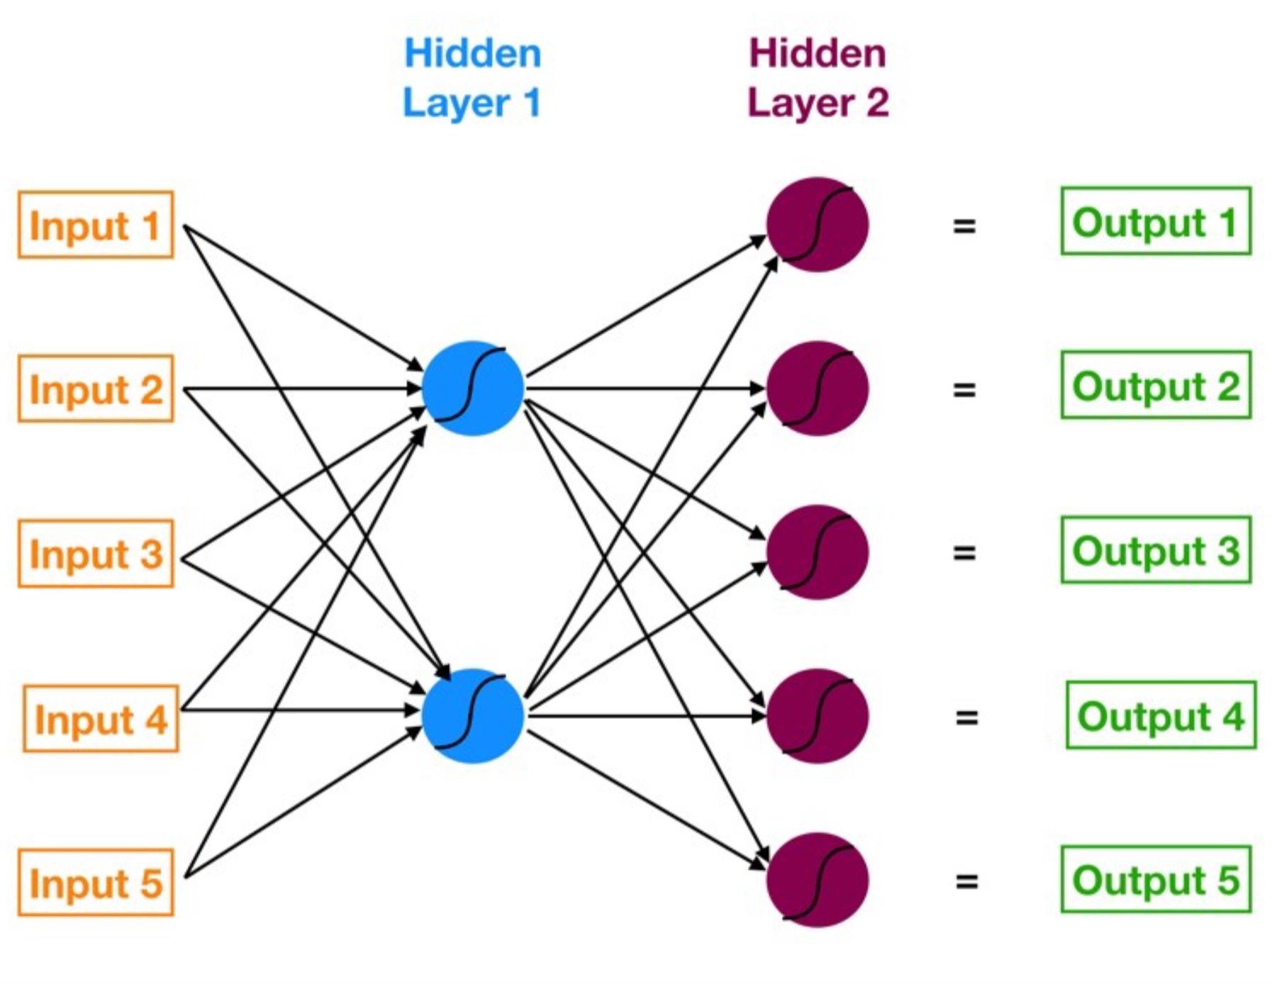

Slide 4
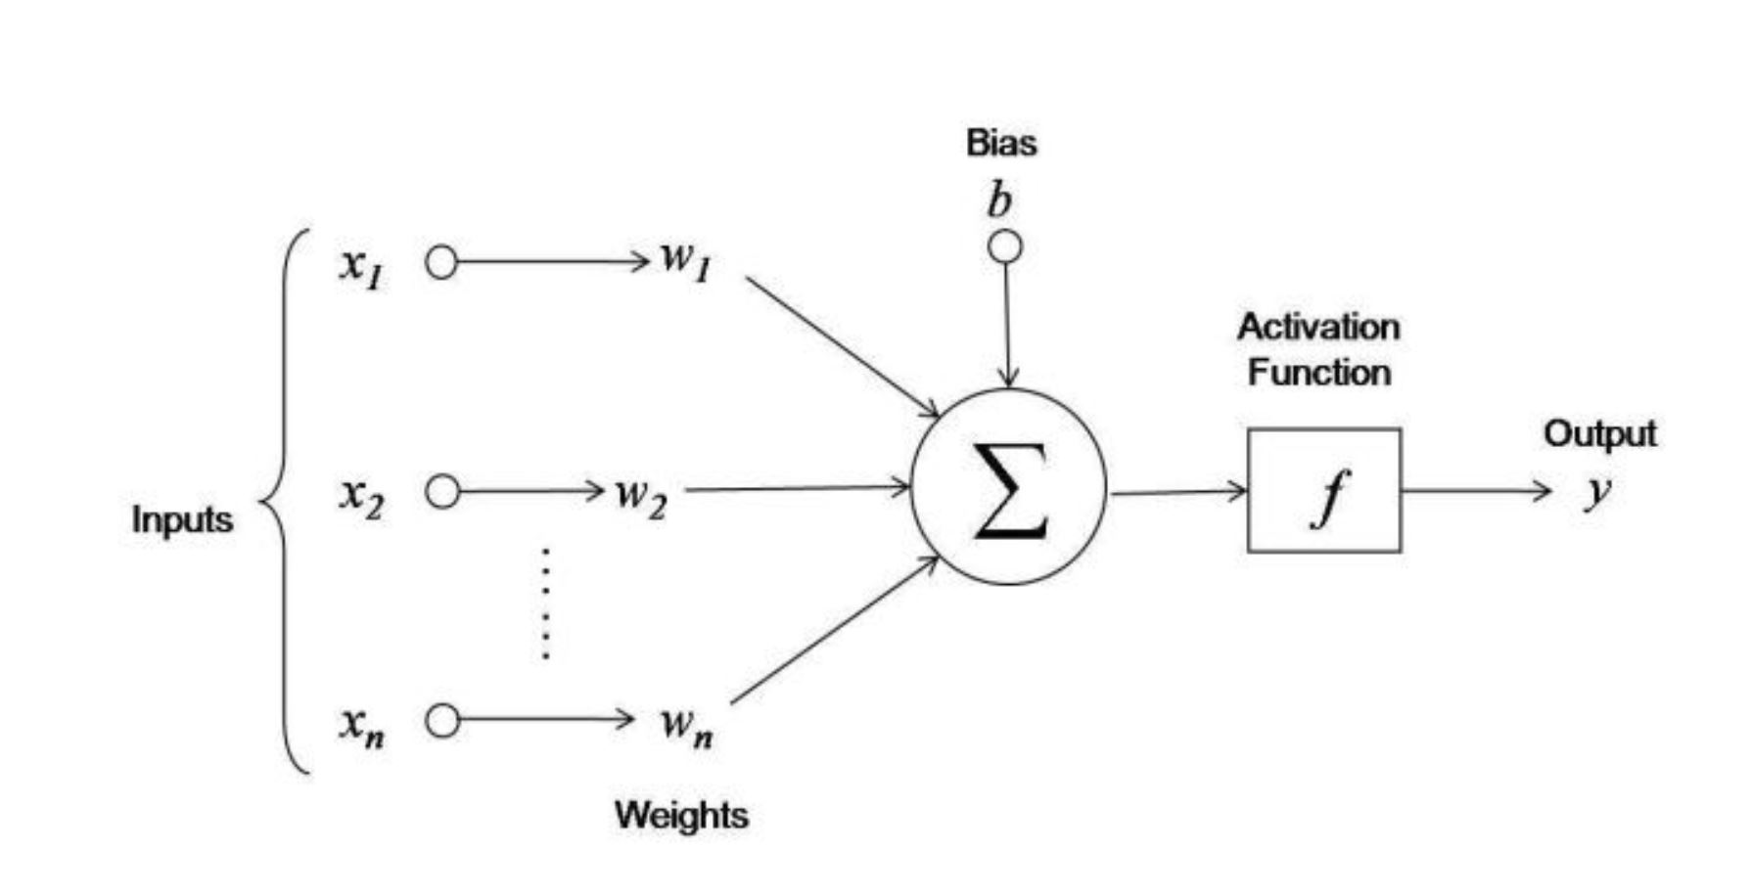
How it works?

Slide 5
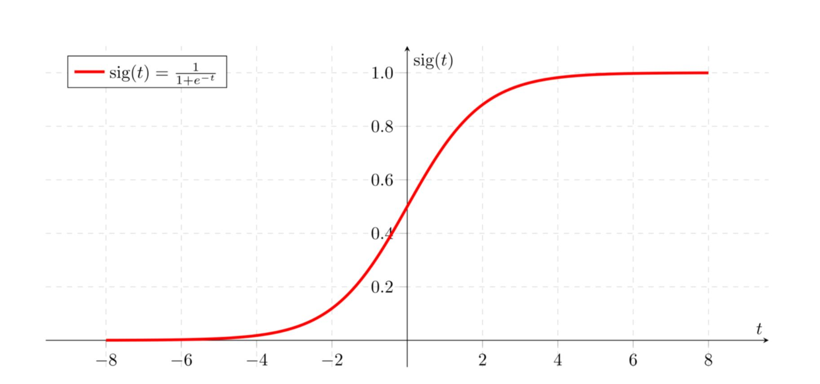
How it works?

Slide 6
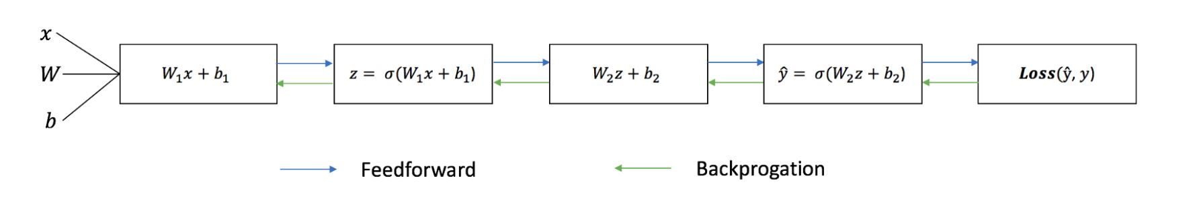
How it works?

Slide 7
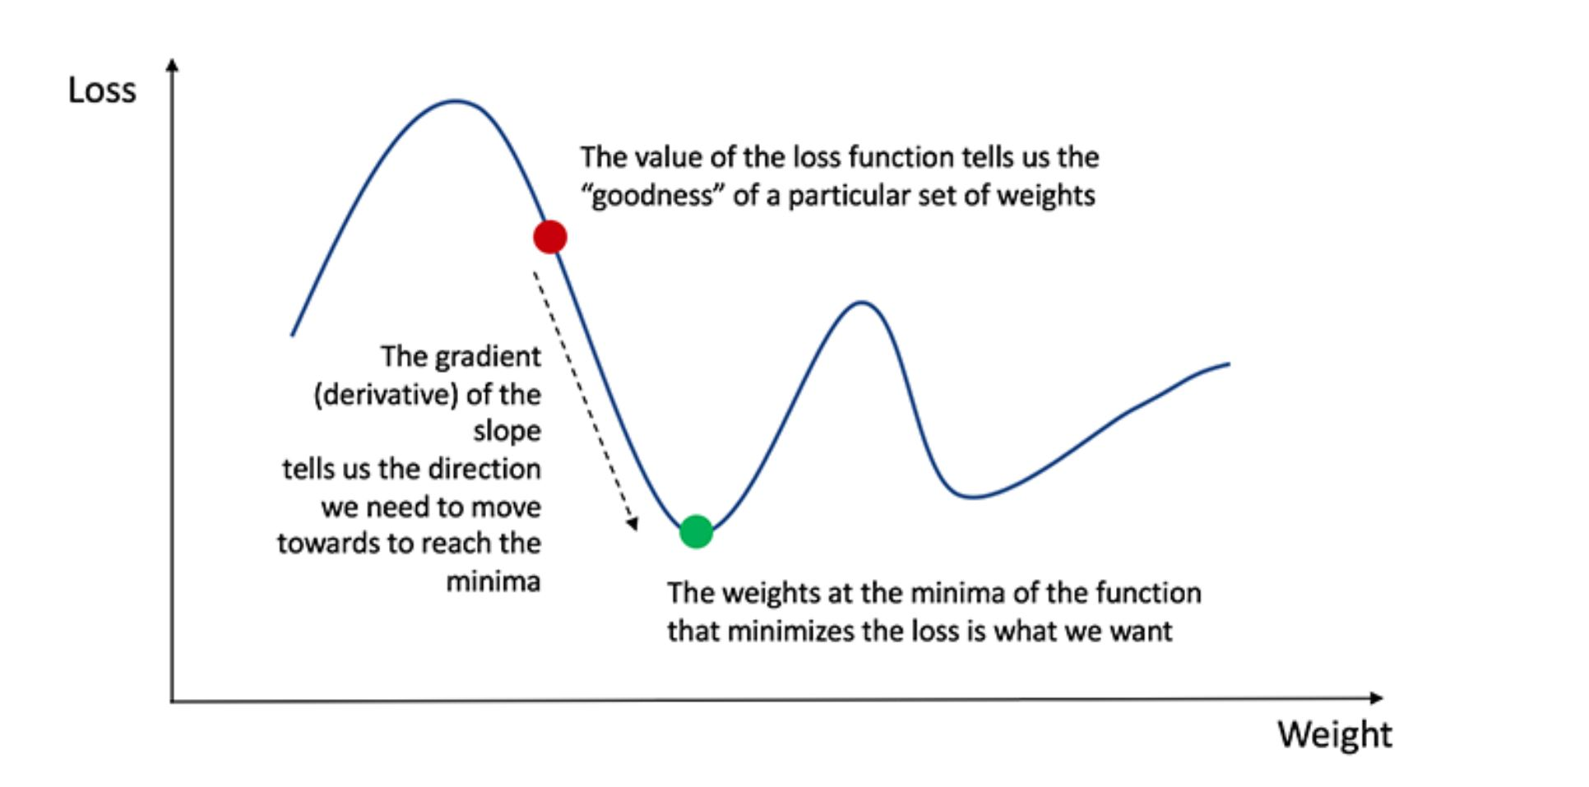
How it works?

